Slide 1

Concrete Remaining Life Prediction
Yi-Leng Chen
Feb 2, 2024

Slide 2
CONTENTS
Introduction
Equation
Goal statement
Assumption
Input and Output
Example of calculation

Slide 3
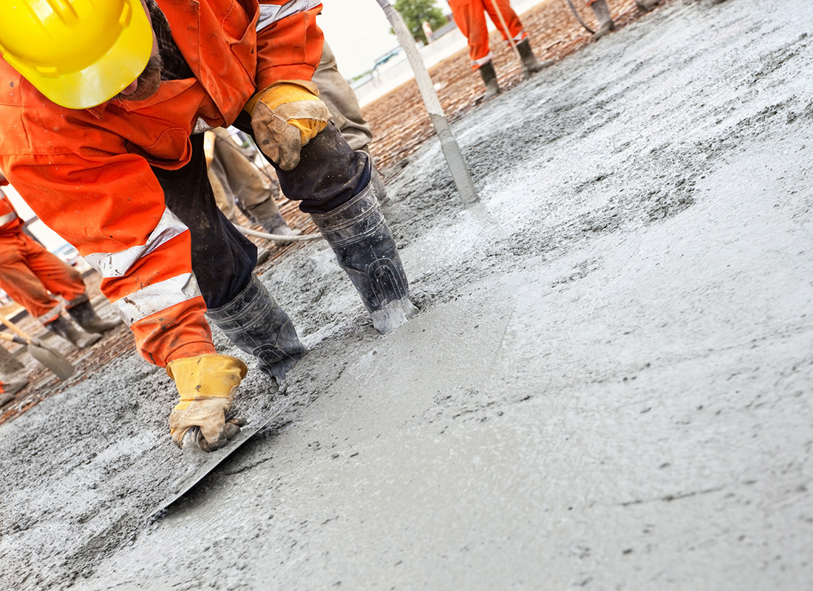
1
INTRODUCTION
In 1992, a laboratory in the United States published a paper ^{[1]} which emphasizing the importance of predicting the remaining life of concrete structures.
[1] Building and fire research laboratory. (1992). Methods for Predicting Remaining Life of Concrete in Structures.https://nvlpubs.nist.gov/nistpubs/Legacy/IR/nistir4954.pdf
[2] Avalon_Studio.(2011). Construction workers smooth the concrete stock photo [Online image].iStock.https://www.istockphoto.com/photo/construction-workers-smooth-the-concrete-gm186821913-17024671

Slide 4
2
GOAL STATEMENT
1
This project aims to develop a program that implements the theories, with the goal of predicting the remaining service life of concrete structures.

Slide 5
3
INPUT AND OUTPUT
Input
Weather open data from Canada government
Output
Remaining service life of the concrete

Slide 6
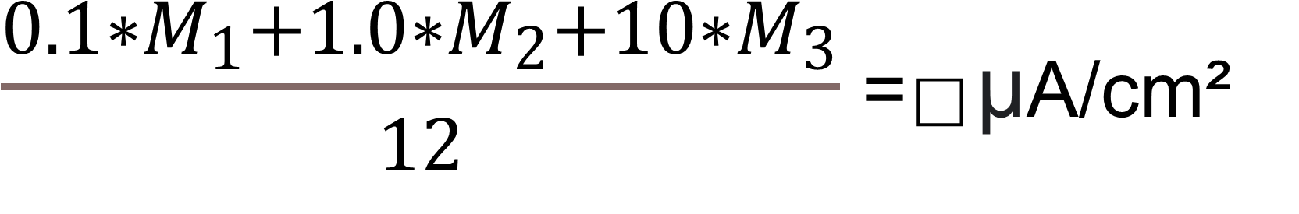
EQUATION
5
Average corrosion rate of a year
$\frac{0.1∗M_{1}+1.0∗M_{2}+10∗M_{3}}{12}$ = ⃞ µA/cm²
M₁: Number of months that relative humidity is below 70%
M₂: Number of months that relative humidity is between 70 and 100%
M₃: Number of months that rain occurs
0.1, 1.0, 10: Coefficient that weighs the impact of corrosion rates (Icorr)
Notes:
The corrosion current density (often expressed in µA/cm²) is a measure of the rate at which electrons are transferred in the corrosion process. It provides information about how quickly the metal is corroding per unit area. Microamperes (µA) represent the flow of electric current associated with the electrochemical reactions taking place during corrosion.

Slide 7
EQUATION
5
Relationship between corrosion rates (Icorr) and remaining service life
Corrosion rates (Icorr) | Remaining service life
0.5 µA/cm² | no corrosion damage expected
0.5 ~ 2.7 µA/cm² | corrosion damage possible in the range of 10 to 15 years
2.7 ~ 27 µA/cm² | corrosion damage expected in 2 to 10 years
> 27 µA/cm² | corrosion damage expected in 2 years or less

Slide 8
ASSUMPTIONS
4
Relative humidity is the only factor that influences Icorr.
Distribute based on M₁ , M₂ and M₃ three periods
The relative humidity value needs to remain consistently below 70% for a month to be considered in the calculation of the M₁ value. The same applies to the M₂ and M₃ values.
The relationship between M₁ and M₂ is mutually exclusive to M₃. In other words, there is no rain during the M₁ and M₂ periods.

Slide 9
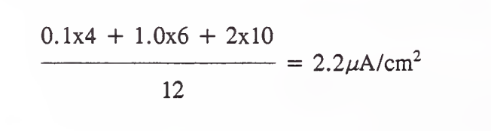
EXAMPLE OF CACULATION
6
Number of months
Coefficient

Slide 10
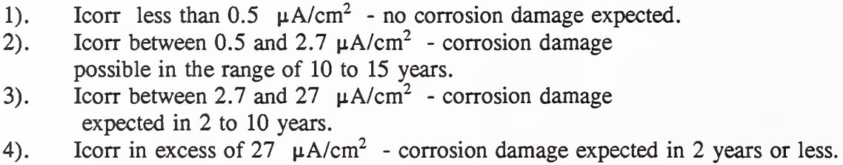
6
EXAMPLE OF CACULATION

Slide 11
Questions?

